Slide 1
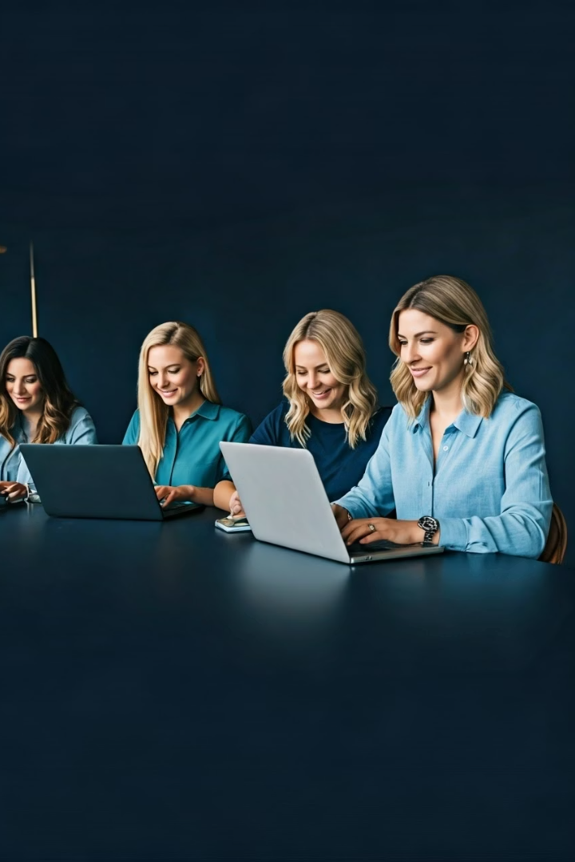

Media Spot: Transforming Words into Growth Tools
Media Spot is a digital marketing startup founded by five passionate women, specializing in content creation and copywriting. We help businesses effectively communicate their brand message through creative, persuasive, and high-quality content.
The founders are: Habiba Hossam, Nourhan Gamal, Sara Mohamed, Logeen Wael and Lamiaa Mohamed.
by Habiba Hossam

Slide 2


Our Core Services
Social Media Content
Website Copy
Blog Writing
Persuasive homepages, about pages, and service descriptions that convert visitors.
SEO-optimized articles that drive traffic and establish brand authority.
Engaging captions, posts, and storytelling for platforms like Instagram, Facebook, LinkedIn, and X.
Marketing Campaign Copy
Compelling advertisements, email marketing content, and promotional materials.

Slide 3
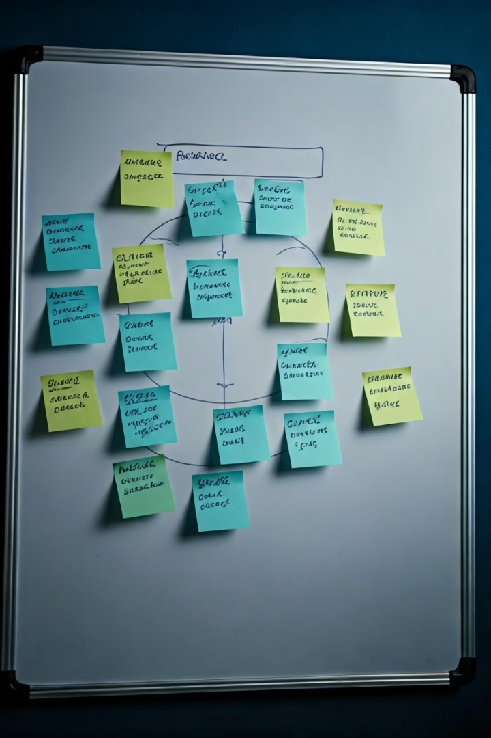
Business Canvas Model
Our business model focuses on creating value through tailored digital marketing solutions, leveraging key partnerships, and maintaining strong customer relationships to drive sustainable growth.

Slide 4
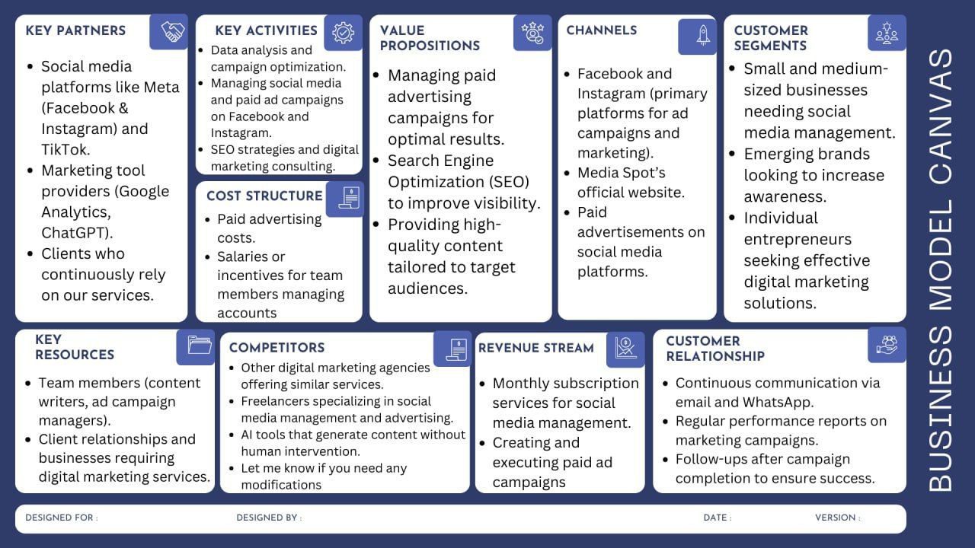
Business Canvas Model

Slide 5





SWOT Analysis
Strengths
Weaknesses
Diverse service offerings
Limited brand recognition
Innovation & creativity
Resource constraints
Customer-centric approach
Limited project scale
Opportunities
Threats
Growing digital marketing
demand
Intense market competition
Rapid technological changes
Market expansion
Strategic partnerships
Economic volatility

Slide 6

SMART Objectives
Increase Brand Awareness
Reach 5,000 accounts and gain 2,000 new followers on Instagram and Facebook
within 6 months.
Optimize Resource Allocation
Improve cost efficiency and streamline workflows within 12 months..
Strengthen Workforce Development
Conduct 12 training sessions and certify all team members on core skills within 12 months.
Expand Services
Introduce 1 new premium service and generate 15 qualified leads for it within 6 months.

Slide 7
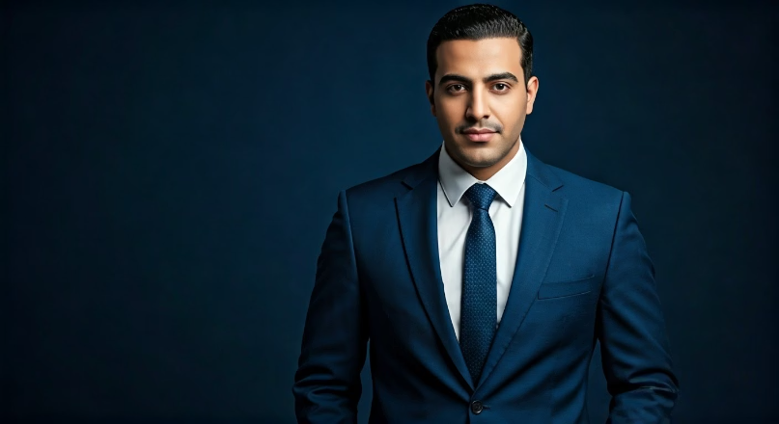
Meet Our Buyer Persona: Adam
Adam: The Ambitious Business Owner
35 years old, married, from Tanta, Gharbia
Social Class: A, A+
Occupation: Business Owner (Doctor, Engineer, Lawyer, Professor, or Entrepreneur)
Goals: Strengthen online presence, increase customer engagement, improve brand messaging
Platform: Facebook & Instagram Interests: Business growth, digital marketing, branding, entrepreneurship, Business podcasts & books, Gym & healthy lifestyle, Reels browsing, Networking events, Coffee & Coworking spaces

Slide 8
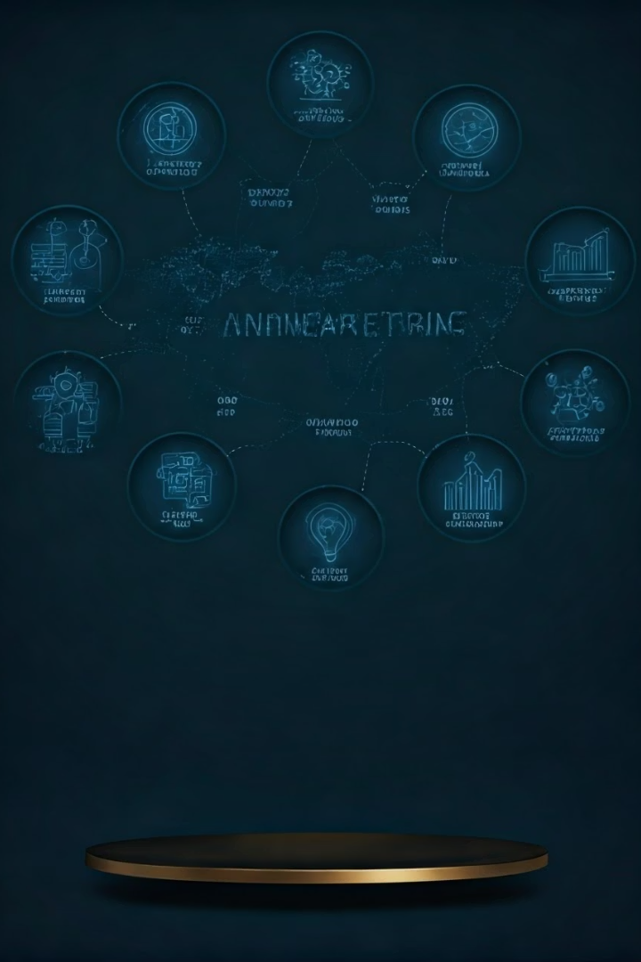
Our Unique Selling Proposition
We empower small businesses and emerging brands to grow their online presence through expertly managed social media campaigns, data-driven advertising strategies, and high-quality, SEO-optimized content—delivered with personalized service and real-time performance tracking.

Slide 9
The 4Ps & 7Ps Marketing Mix
Product
Price
Offering innovative digital marketing services tailored for SMBs and startups.
Competitive and value-based pricing aligned with client budgets and expectations.
Place
Promotion
Primarily online channels leveraging digital platforms for wide-reaching accessibility.
Strategic use of social media, SEO, paid ads, and content marketing to drive leads.

Slide 10
The 4Ps & 7Ps Marketing Mix
People
Physical Evidence
Our team includes expert writers and marketers. They ensure every message fits your brand.
Our social media pages, client feedback, and content samples reflect our quality and credibility.
Process
A streamlined system for content planning, creation, and publishing tailored to each client.

Slide 11
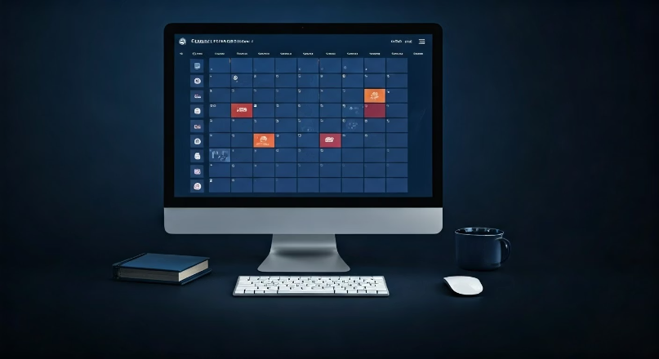
Content Calendar & Action Plan
Key Actions
Daily social media posts
Weekly blog articles
Bi-weekly reels/videos
Monthly performance analysis
Our content calendar ensures consistent, engaging posts across platforms.

Slide 12
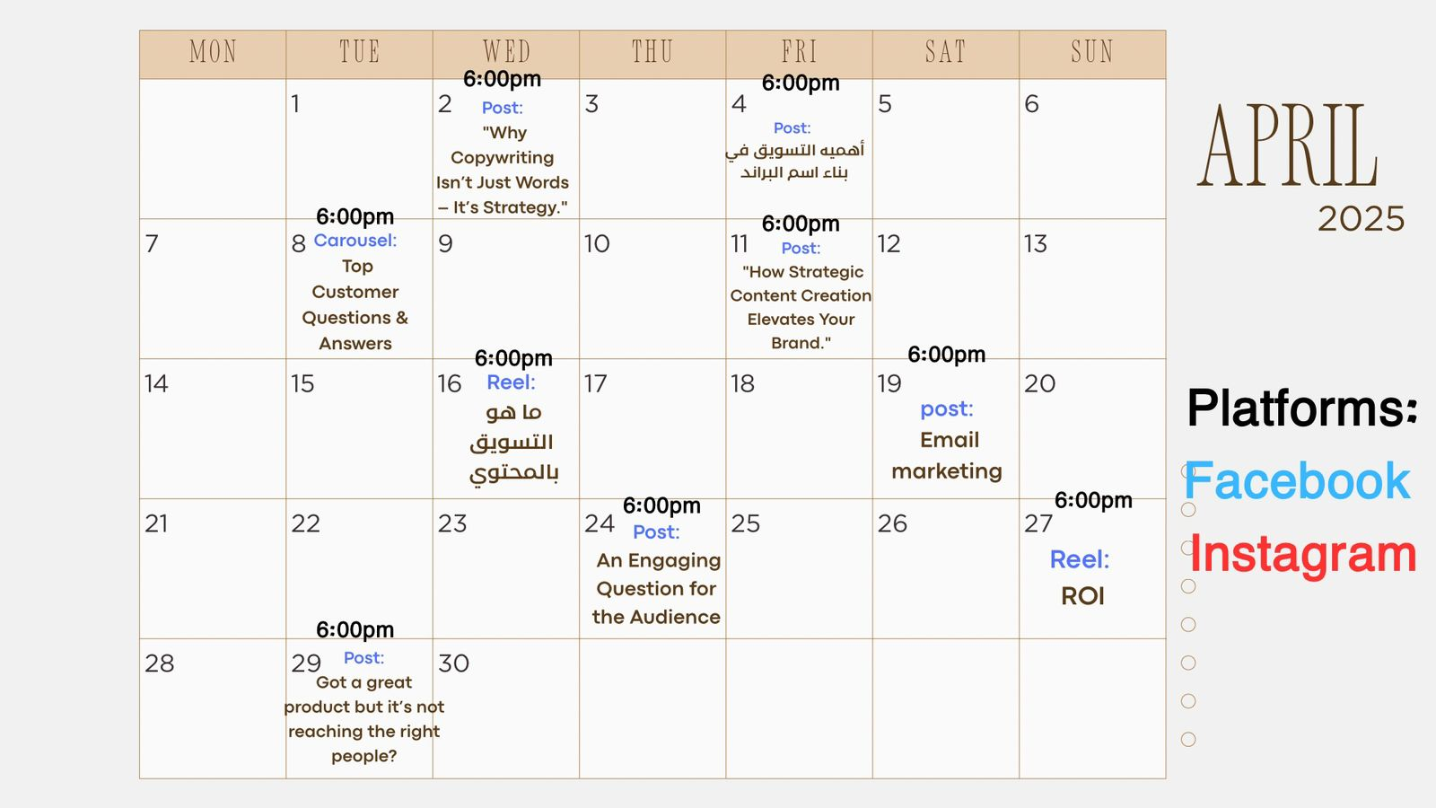
Content Calendar

Slide 13
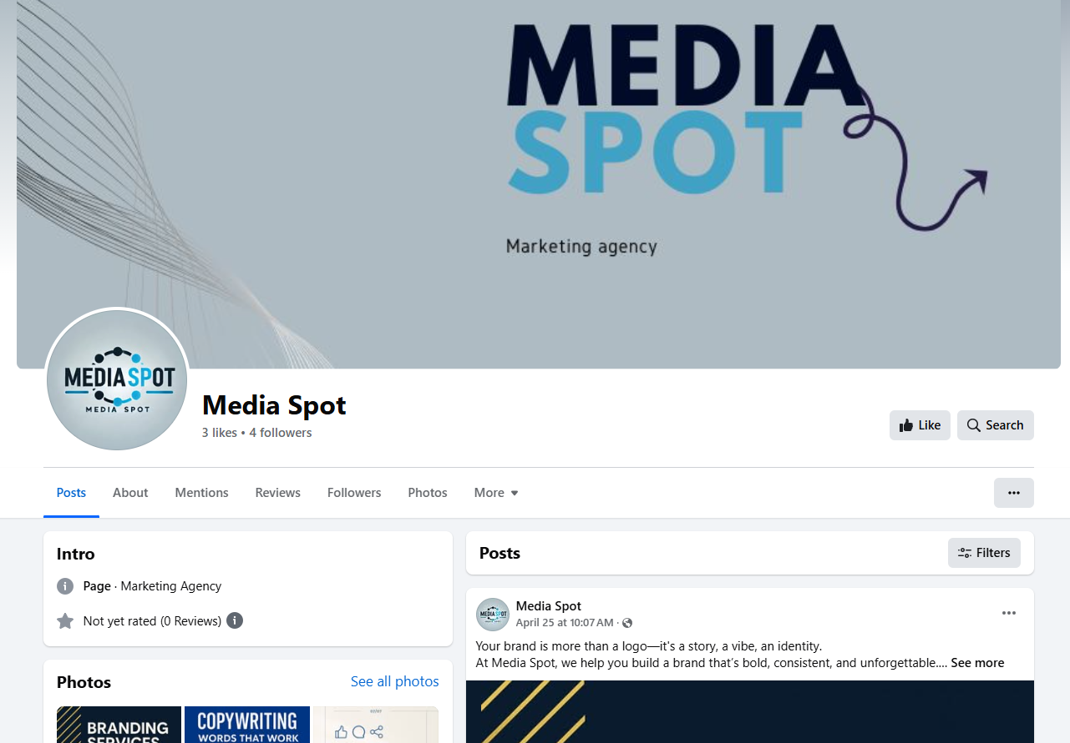
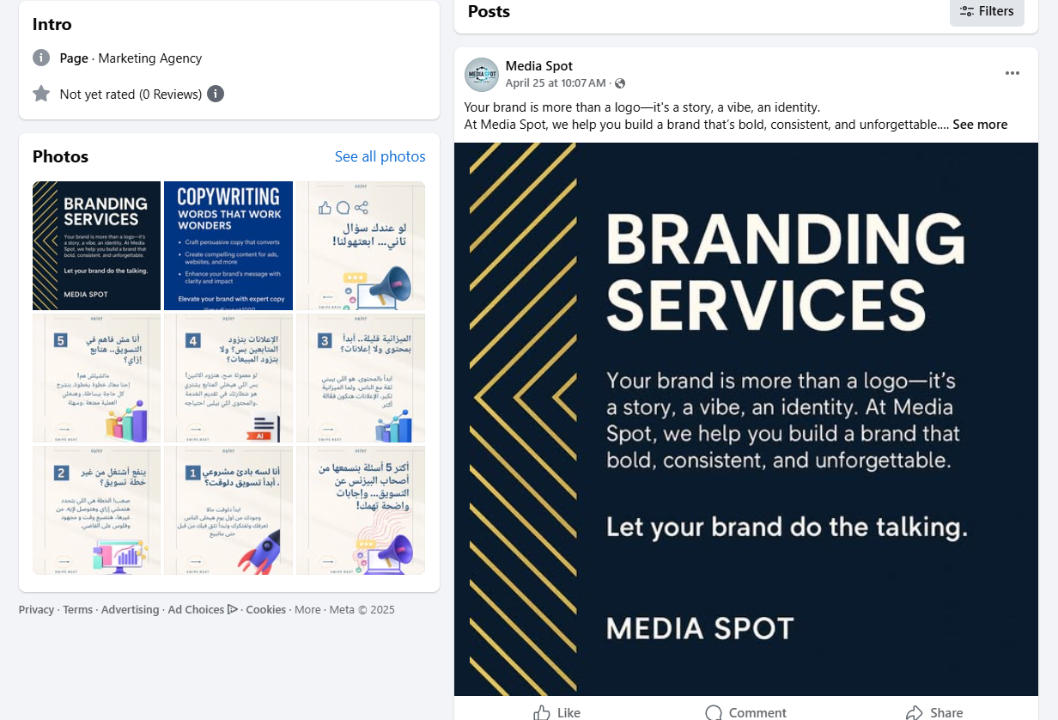
Action Plan
Facebook

Slide 14
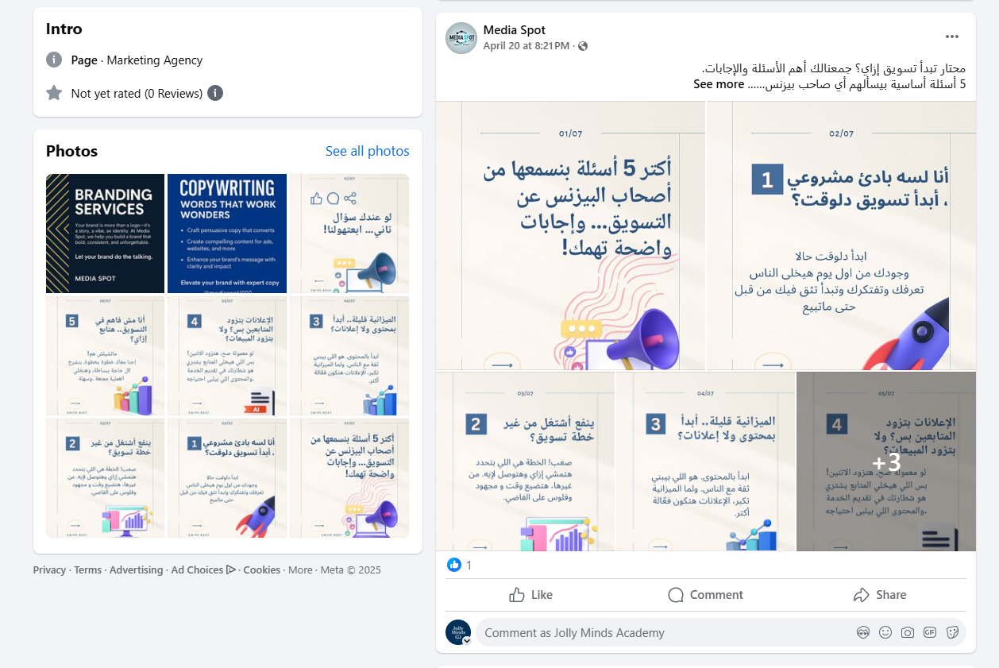
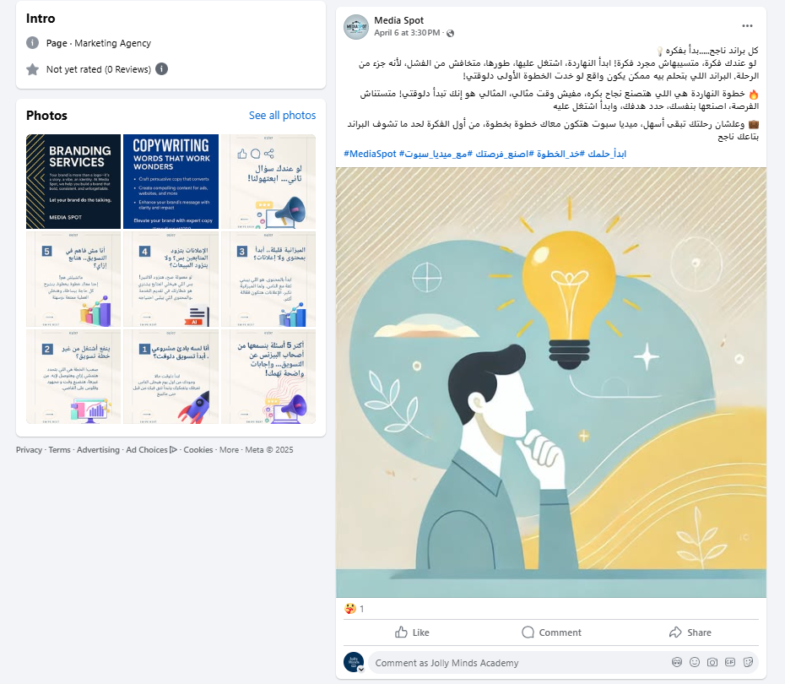
Action Plan
Facebook

Slide 15
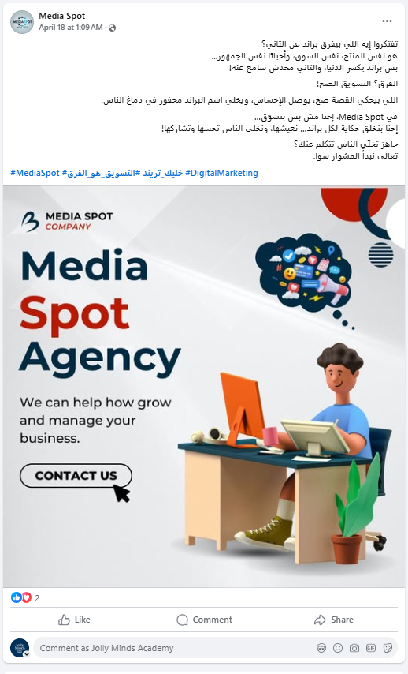
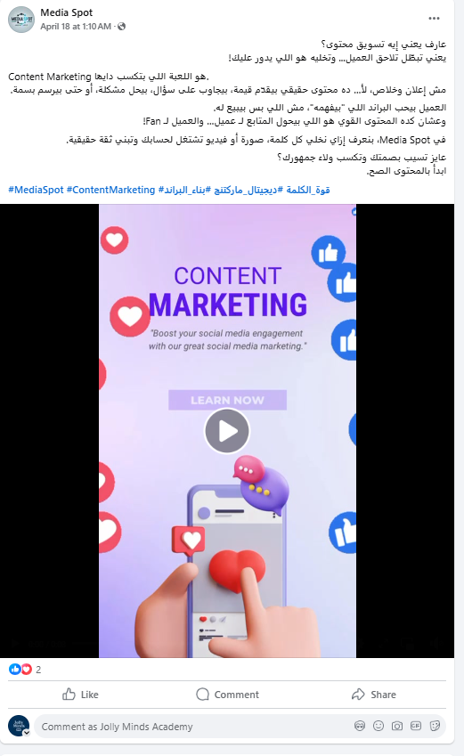
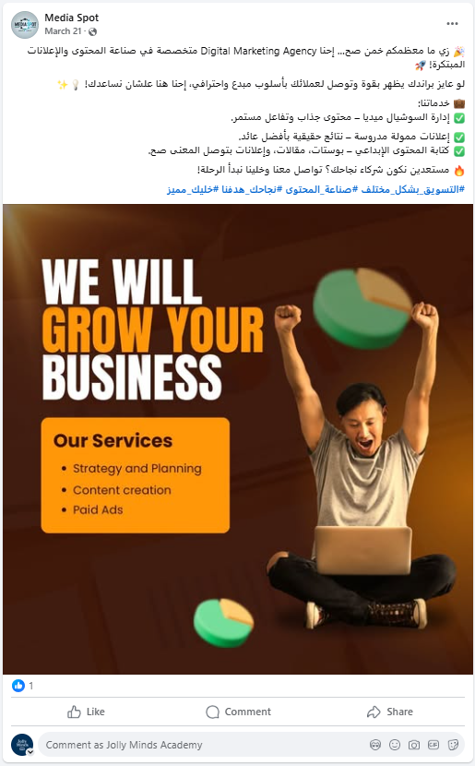
Action Plan - Facebook

Slide 16
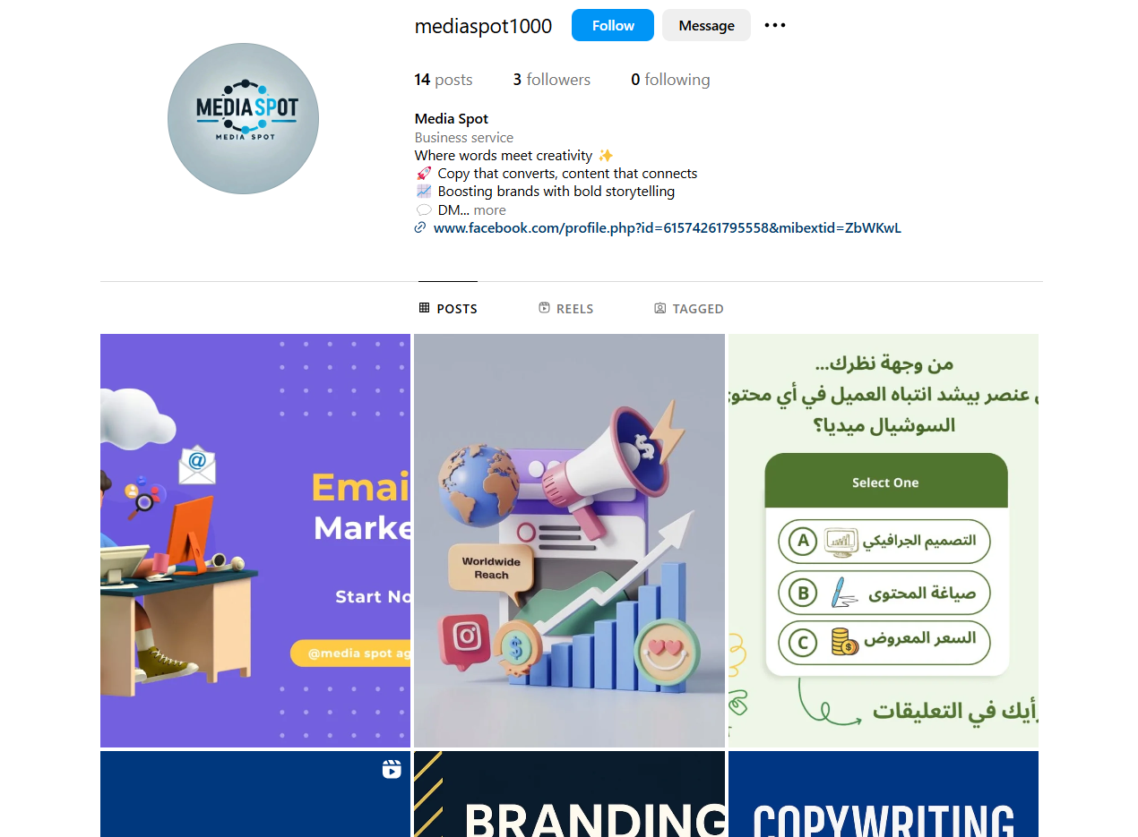
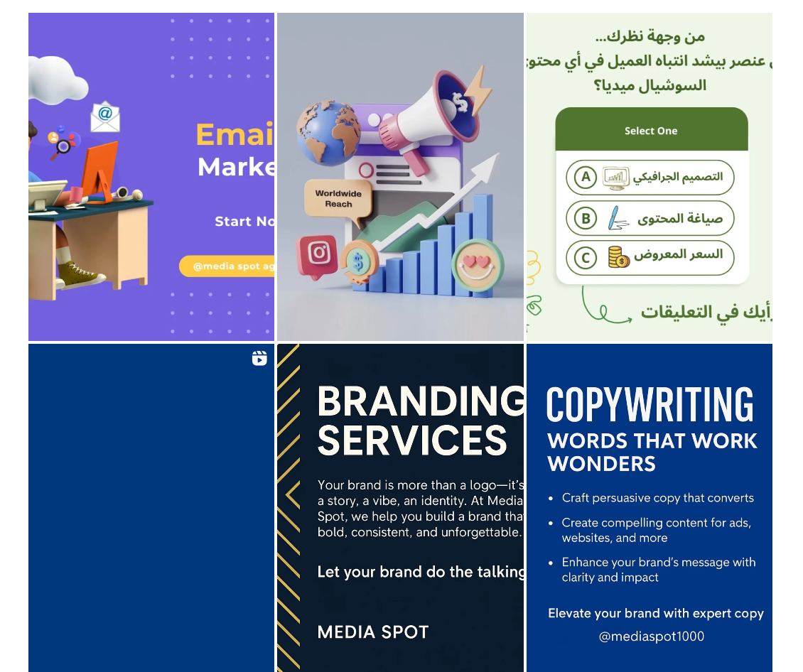
Action Plan
Instagram

Slide 17
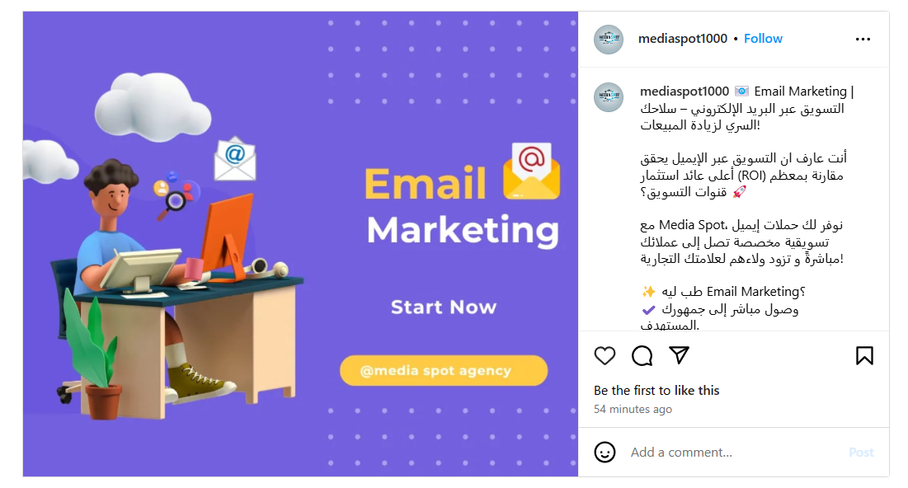
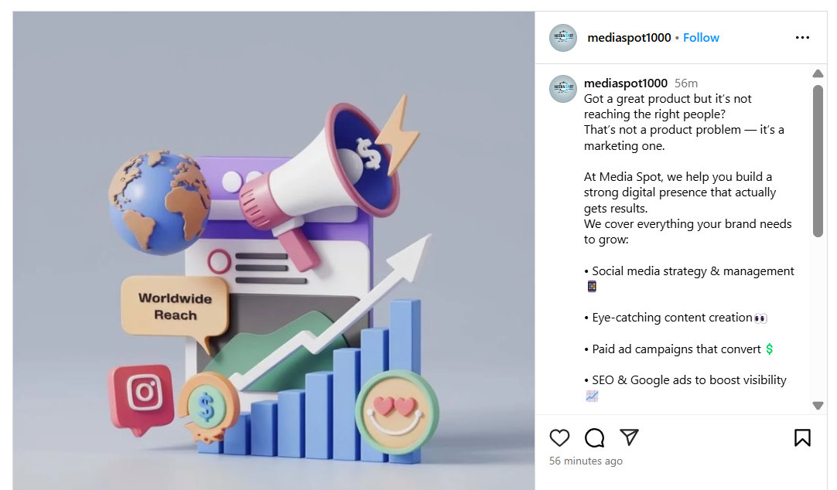
Action Plan
Instagram

Slide 18
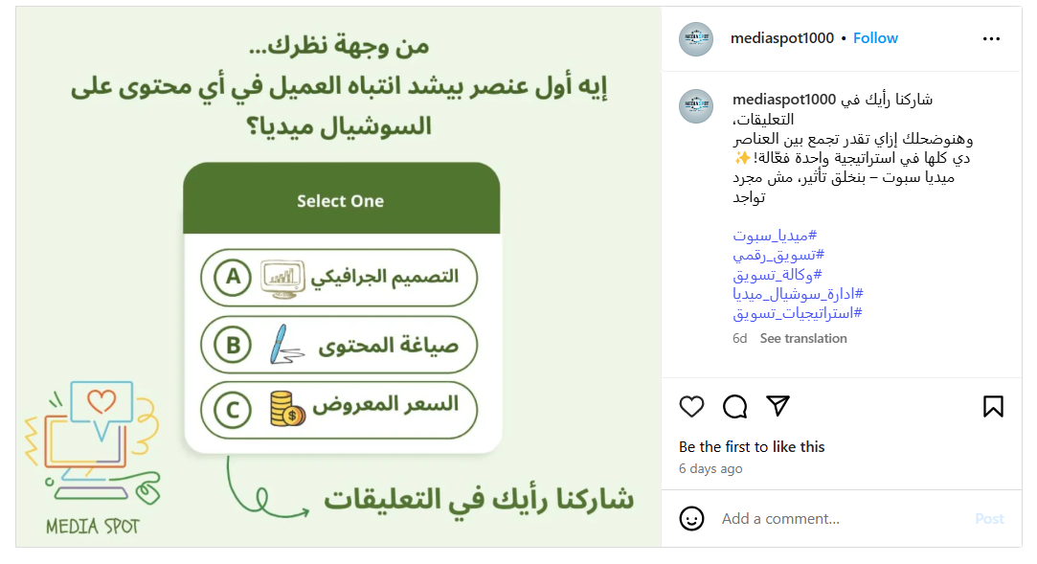
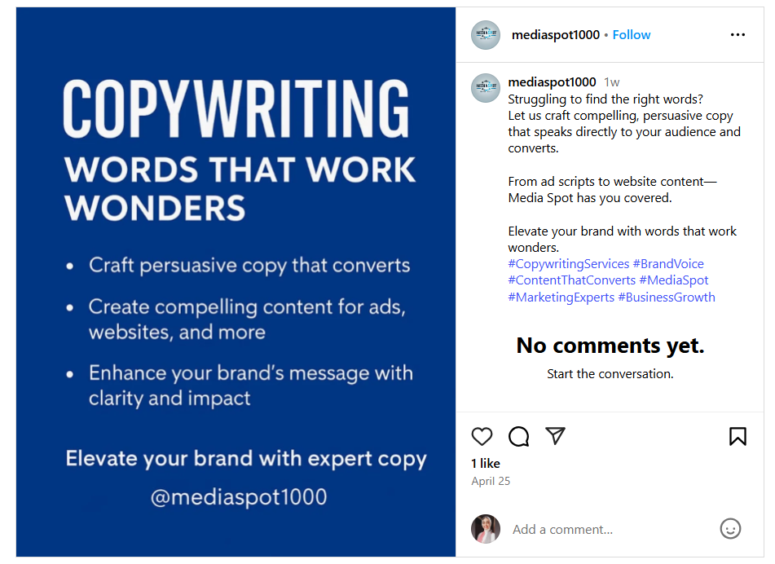
Action Plan
Instagram

Slide 19
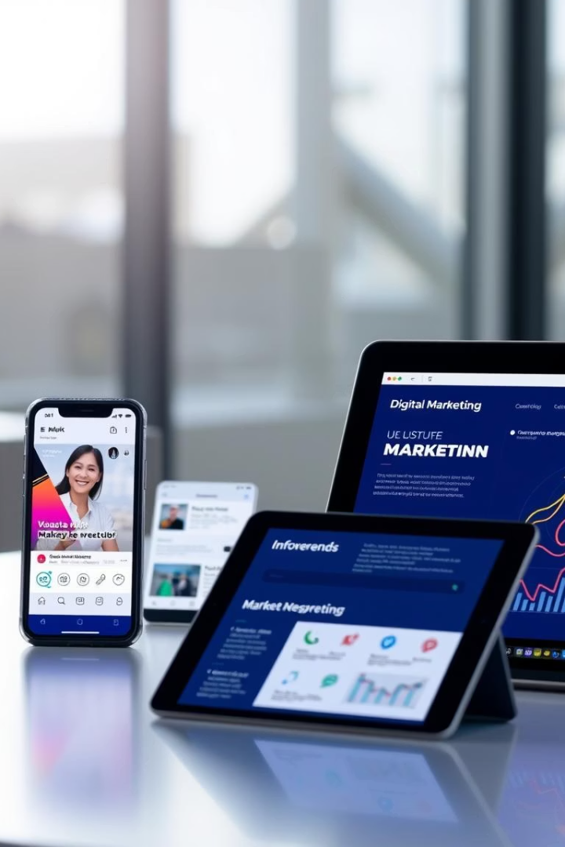
Ad Content Published
Our latest ads have launched across multiple platforms, targeting key audiences.
We track engagement and optimize in real time to maximize ROI.

Slide 20
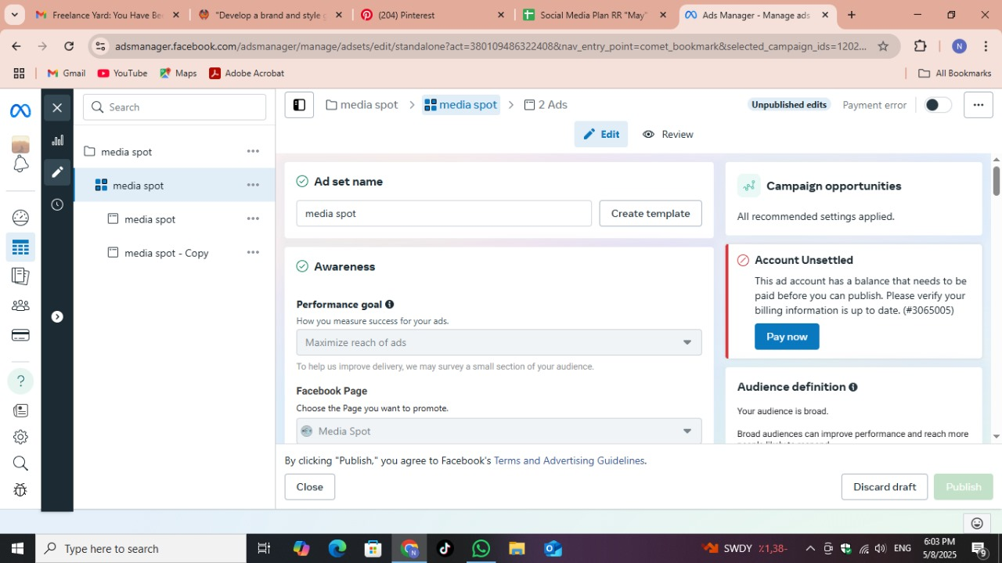
Ad Content Published

Slide 21
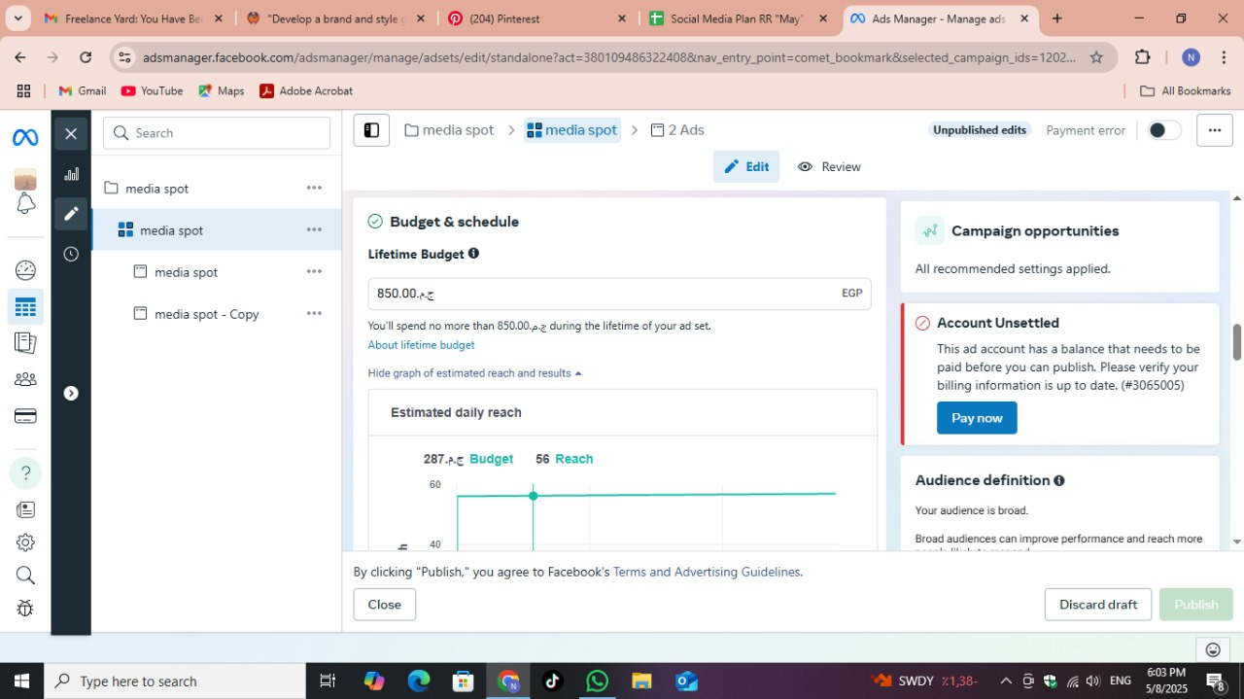
Ad Content Published

Slide 22

Ad Content Published

Slide 23
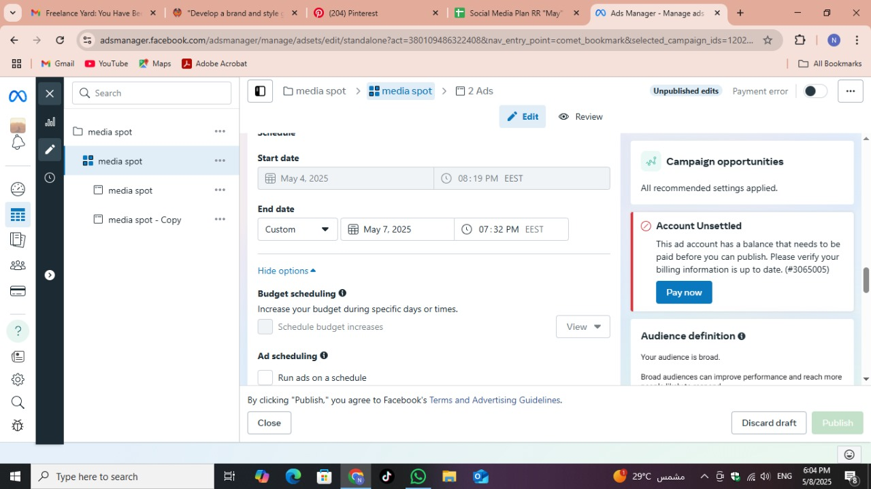
Ad Content Published

Slide 24
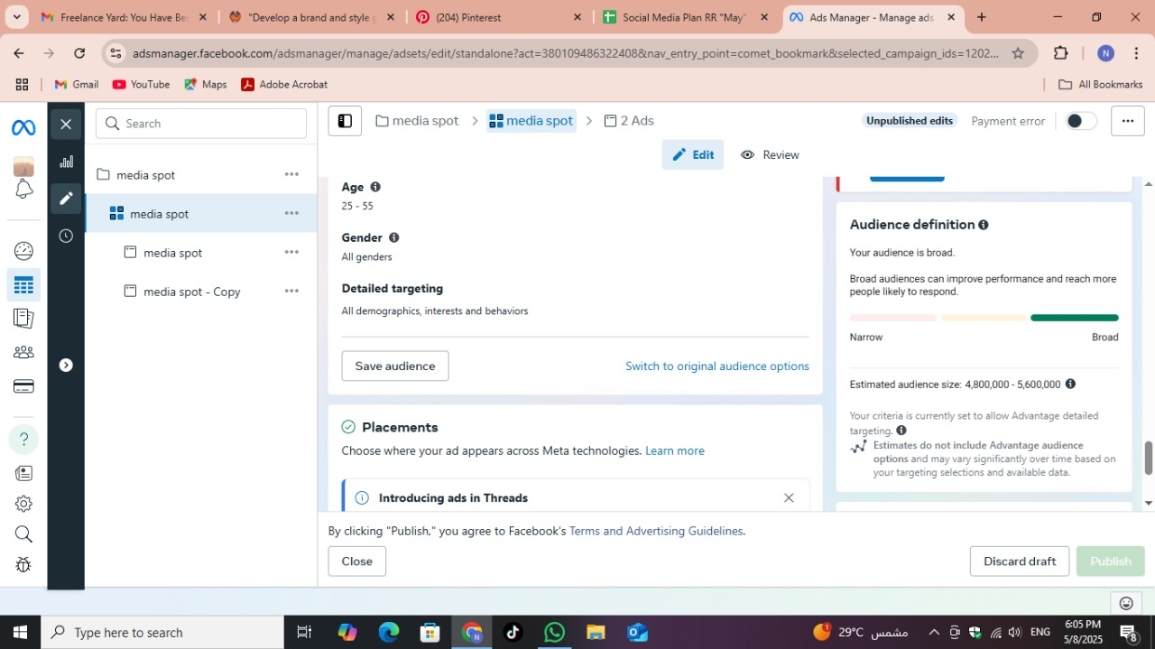
Ad Content Published

Slide 25
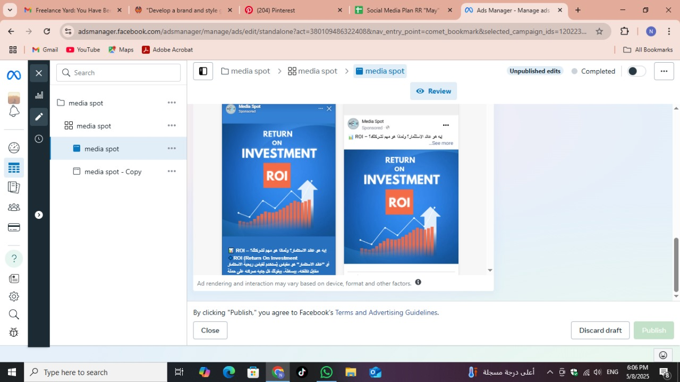
Ad Content Published

Slide 26
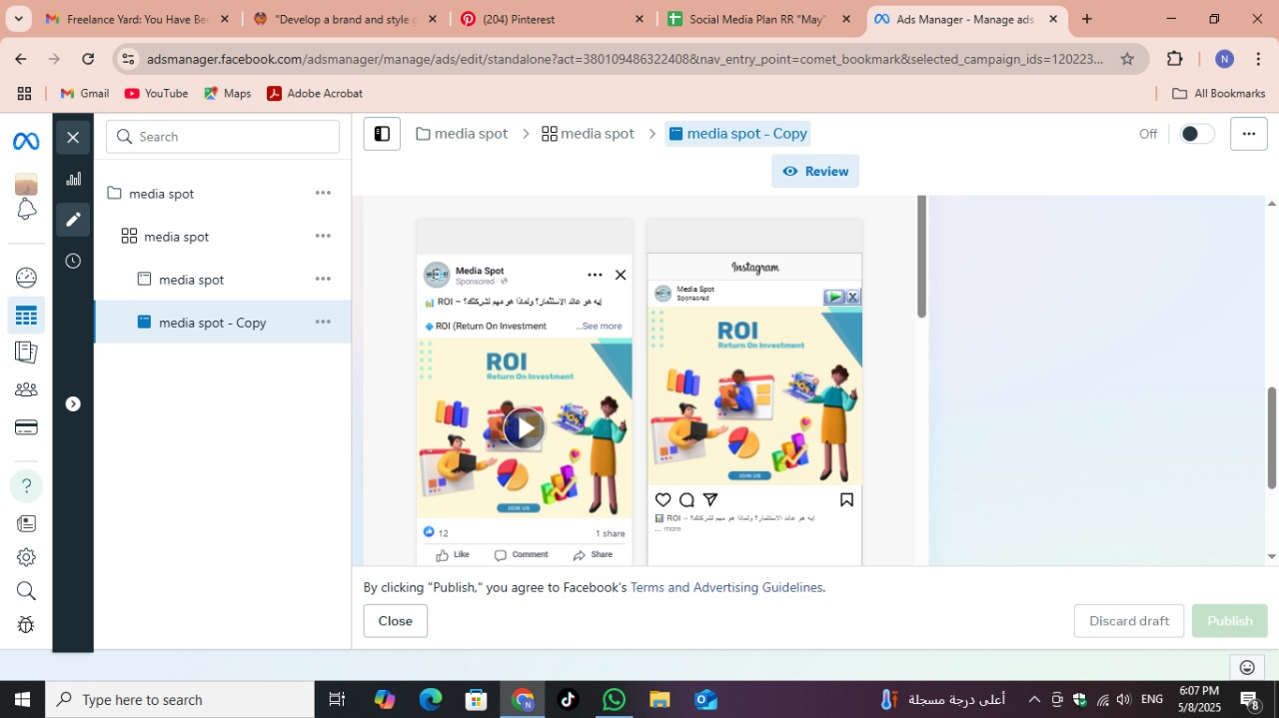
Ad Content Published

Slide 27
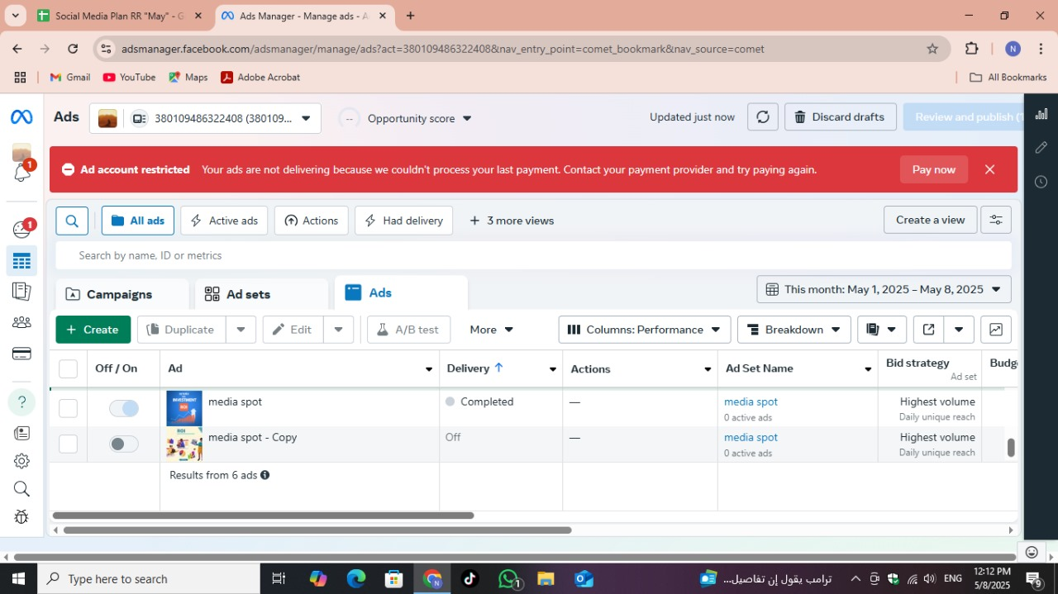
Ad Results

Slide 28
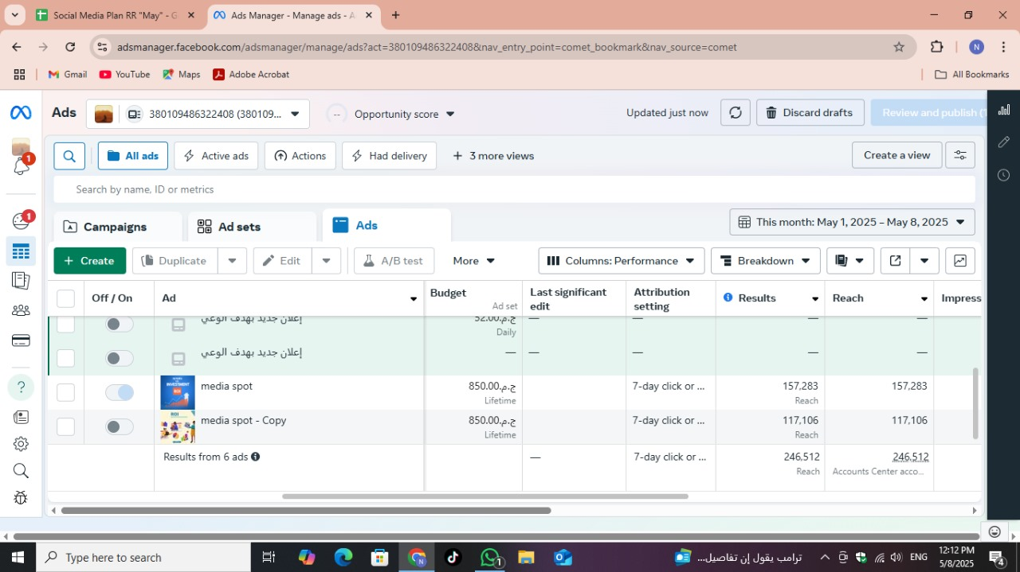
Ad Results

Slide 29
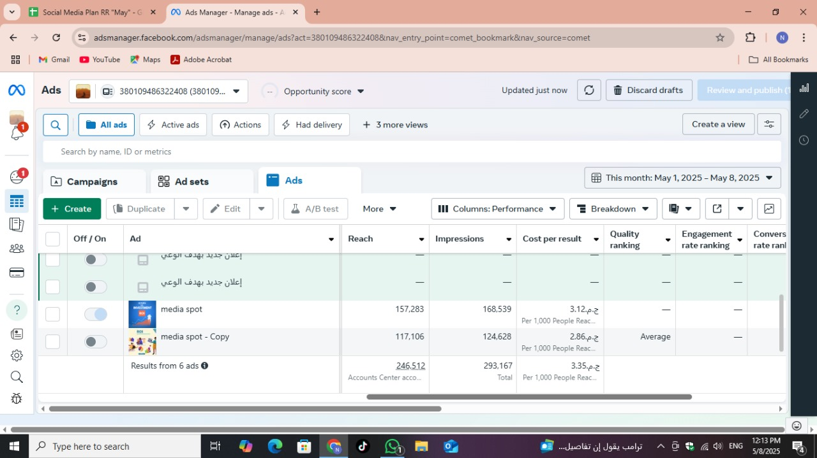
Ad Results

Slide 30
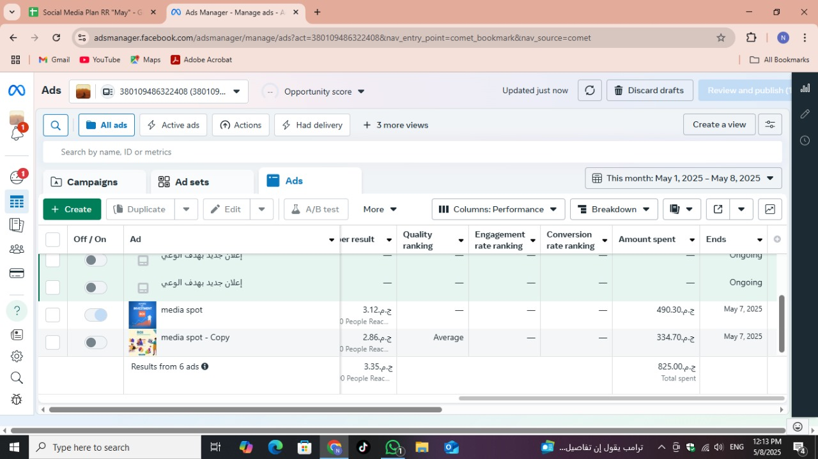
Ad Results

Slide 31
Controls & KPI
Monitoring key performance indicators keeps our marketing strategy on track.
We apply controls to measure ROI, engagement, and conversion effectiveness.
✅ Growth in follower count
✅ Higher post reach and impressions
✅ Improved content engagement (likes, shares, comments)
✅ Increased inbound messages and inquiries
✅ Consistent posting and content quality

Slide 32
Recommendations and Improvements
Enhance Lead Conversion: Refine targeting and optimize call-to-action strategies to boost leads above 15%.
Improve Client Retention: Strengthen community engagement and offer personalized perks to increase retention.
Expand Content Variety: Introduce interactive formats like polls and webinars to sustain engagement.
Leverage AI Tools: Utilize AI for data-driven content personalization and marketing automation.

Slide 33
Thank You

